Slide 1
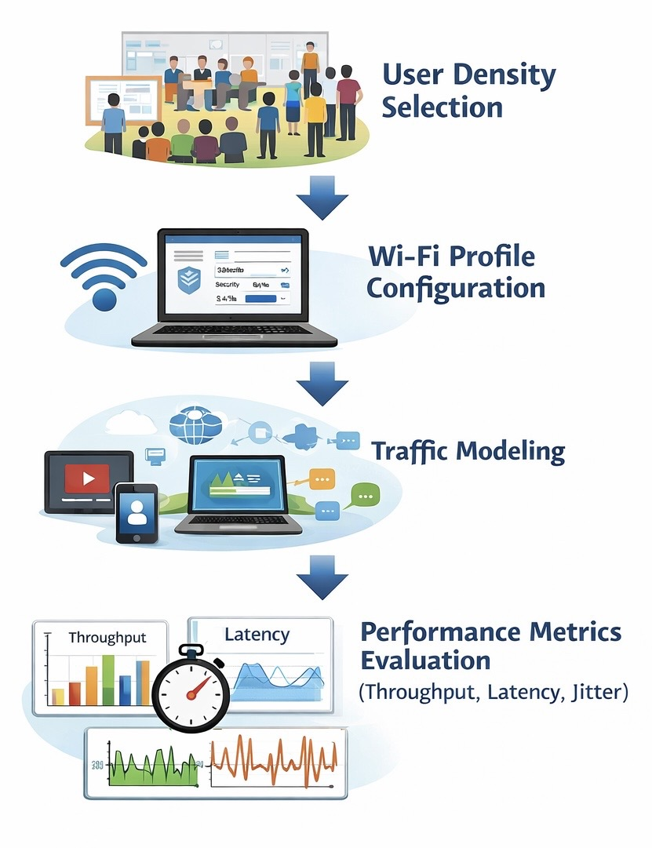
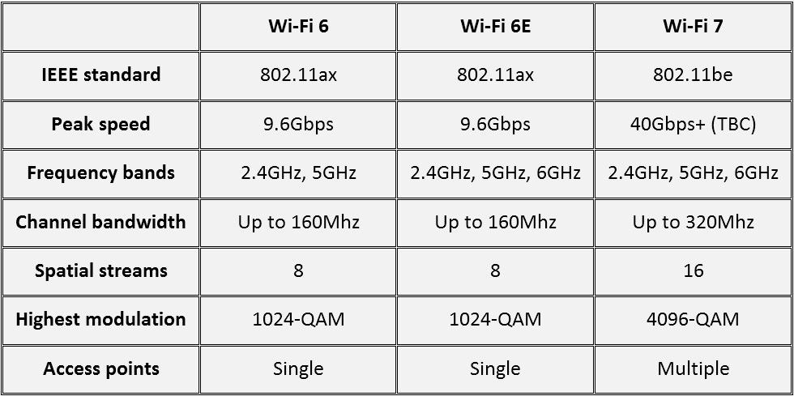
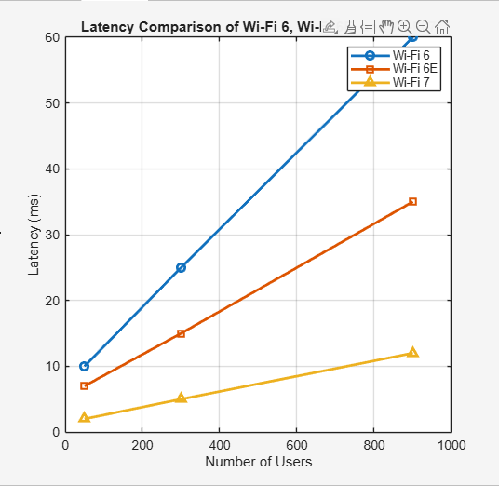
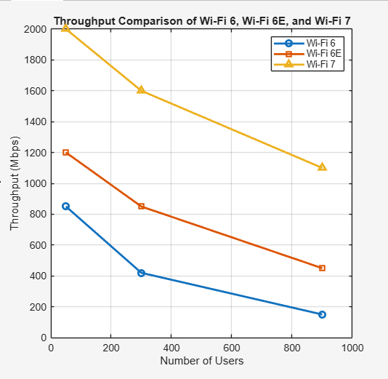


Comparative Analysis of Wi-Fi 6, 6E, and 7 in Smart Campus Networks
ID: 223028877
ID: 223005582
Authors: Bader Al-Muqait & Abdulrahman Aldehilan
King Faisal University, computer network department
Abstract
University campuses face Wi-Fi performance issues during peak usage due to many connected users. This project compares Wi-Fi 6, Wi-Fi 6E, and Wi-Fi 7 for smart campus environments. MATLAB simulations are used to evaluate throughput, latency, and jitter under different user load scenarios. The results show that Wi-Fi 7 provides better speed, lower delay, and more stable connectivity.
Keywords
Wi-Fi 6, Wi-Fi 6E, Wi-Fi 7, Smart Campus, MATLAB Simulation, Wireless Networks
IV. Experiments
The experiments in this study are conducted using MATLAB-based analytical simulations to evaluate wireless network performance in a smart campus environment. Different user load scenarios are considered to represent low, medium, and high network usage during various times of the day. These scenarios reflect realistic campus conditions where many students and devices are connected simultaneously.
For each scenario, the performance of Wi-Fi 6, Wi-Fi 6E, and Wi-Fi 7 is analyzed using throughput, latency, and jitter as key evaluation metrics. The experimental results are presented visually to allow clear comparison between the three Wi-Fi generations.
Fig. Example of how the flow works
I. Introduction
We start each class with opening the KFU Black Board so we can download the slides or open an assignment or even opening an online class some students does not have a Personal hotspot so they need to use the university Wi-Fi if they could not reach the Wi-Fi they will be left behind and lost the ability of keep up with the doctor.
Older Wi-Fi technologies are not designed to efficiently handle high user density environments such as classrooms and lecture halls.
Newer Wi-Fi generations, including Wi-Fi 6, Wi-Fi 6E, and Wi-Fi 7, aim to improve performance in crowded environments.
With the increasing number of students and connected devices, campus Wi-Fi networks often struggle during peak usage hours. This leads to slow connections and poor user experience.
II. Principle
The basic principle of this work is to compare the performance of different
Wi-Fi generations in a smart campus environment. The study evaluates how Wi-Fi 6, Wi-Fi 6E, and Wi-Fi 7 handle increasing numbers of users by analyzing key performance metrics such as throughput, latency, and jitter. MATLAB-based simulations are used to observe performance trends and identify the most suitable Wi-Fi technology for high-density campus networks.
V. Results and Analyses
A. Throughput
Wi-Fi 7 achieves the highest throughput under all user load conditions. Throughput decreases as the number of users increases, but Wi-Fi 7 maintains better performance than Wi-Fi 6 and Wi-Fi 6E.
B. Latency
Latency increases with user density for all Wi-Fi generations. Wi-Fi 7 shows the lowest delay, making it more suitable for real-time campus applications.
C. Jitter
Wi-Fi 7 provides the most stable performance with the lowest jitter values. This results in smoother communication compared to Wi-Fi 6 and Wi-Fi 6E.
III. Theoretical Modelling
This work is based on an analytical performance comparison model for wireless networks in a smart campus environment. The model considers different Wi-Fi generations and evaluates their behavior under varying user load conditions. The performance is assessed by observing how throughput, latency, and jitter change as the number of connected users increases.
Newer Wi-Fi generations are expected to handle congestion more efficiently due to improved design features. MATLAB is used to apply this model and visualize performance trends without relying on complex physical-layer equations.
Fig.
B. Model Overview
This theoretical model considers a smart campus wireless network where multiple users share the same communication medium. As the number of connected users increases, network congestion occurs, leading to reduced throughput and increased latency and jitter. The model is used to conceptually compare the performance of Wi-Fi 6, Wi-Fi 6E, and Wi-Fi 7 under different user load conditions using MATLAB-based simulations.
VI. Conclusion
This study compared Wi-Fi 6, Wi-Fi 6E, and Wi-Fi 7 for smart campus environments using MATLAB-based simulations. The results show that Wi-Fi 7 provides higher throughput, lower latency, and more stable performance, especially under high user density. These findings indicate that Wi-Fi 7 is the most suitable choice for future smart campus network upgrades
Author email: 223028877@student.kfu.edu.sa
Wi-Fi Performance Analysis (Wi-Fi 6, 6E, and 7) Instructor: Dr. Abdullah Al-Buali College of Computer Science & IT – King Faisal University

